Slide 1
Executive summary best practice
Situation
PowerCo has a problem with customer churn; they believe it is caused by customers' price sensitivities. One possible solution is to provide 20% off to customers who are most likely to start leaving.
Complication
During the process of EDA I have seen the data was highly skewed and this was taken care
Since there were are lot of features using confusion matrix I selected them
I applied Random Forest Classifier. Random Forest Classifier model has been built to predict customers’ churn probability, achieving an accuracy of 0.90 on test set.
Question
Is churn driven by the customers' price sensitivity?
The difference between off-peak prices in December and January the preceding year could be a significant feature when predicting churn

Slide 2
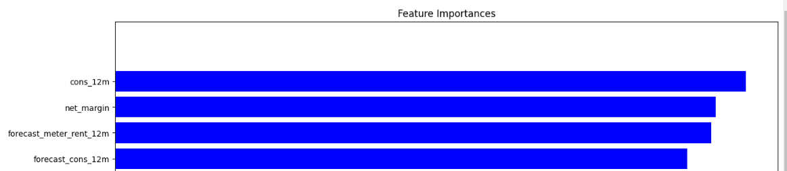
Executive summary best practice
Answer
From this chart, we can observe the following points:
Net margin and consumption over 12 months is a top driver for churn in this model
Margin on power subscription also is an influential driver Time seems to be an influential factor, especially the number of months they have been active, their tenure and the number of months since they updated their contract
The feature that our colleague recommended (Question 2) is in the top half in terms of how influential it is and some of the features built off the back of this actually outperform it
Our price sensitivity features are scattered around but are not the main driver for a customer churning
The last observation is important because this relates back to our original hypothesis:
Is churn driven by the customers' price sensitivity?
Based on the output of the feature importance, it is not a main driver but it is a weak contributor. However, to arrive at a conclusive result, more experimentation is needed.

